Slide 1
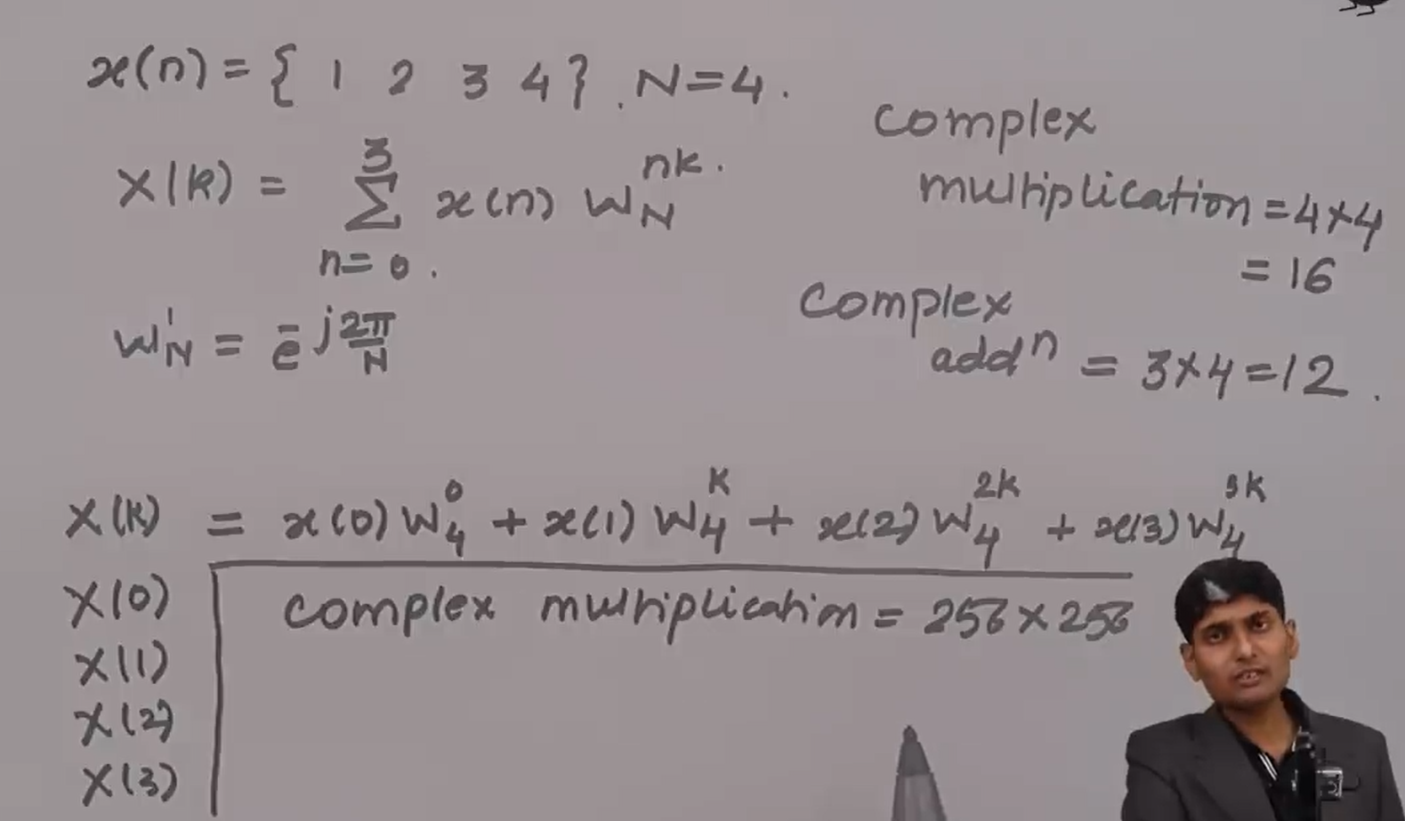

Slide 2
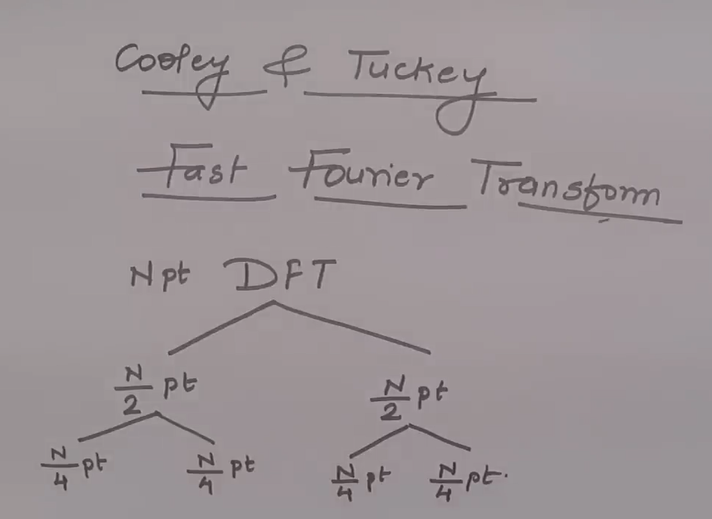

Slide 3
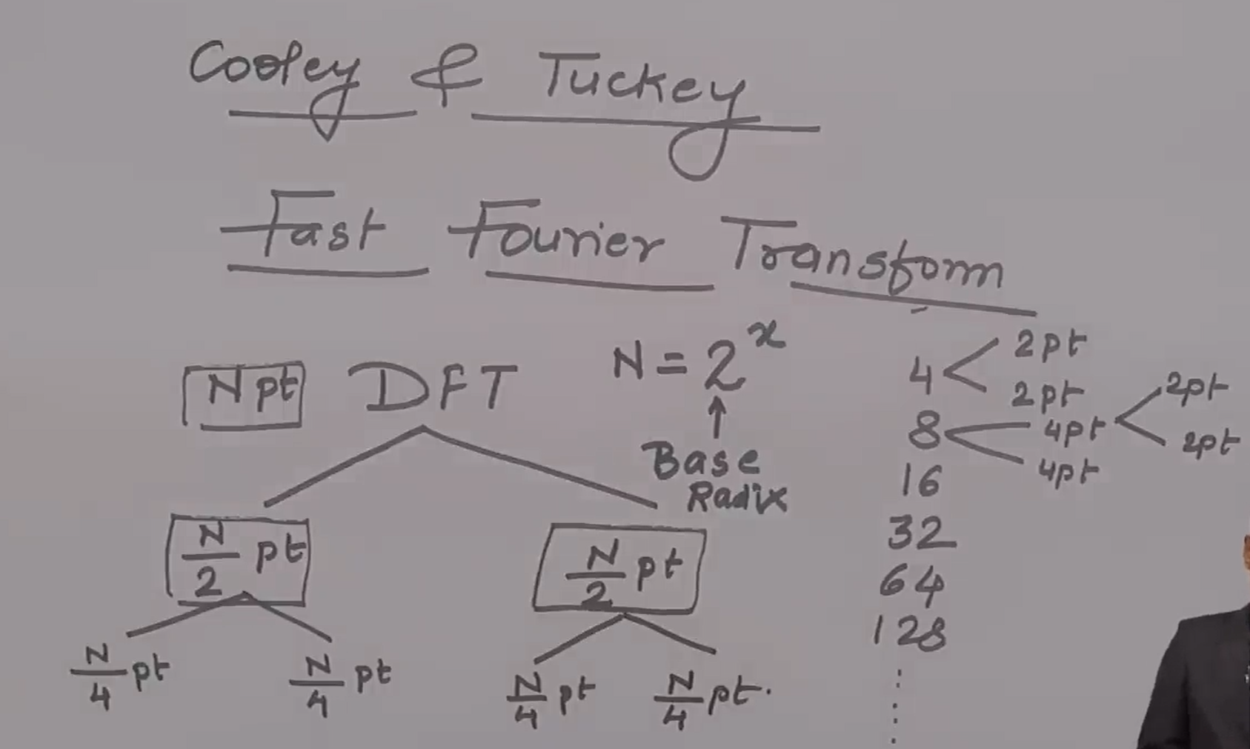

Slide 4
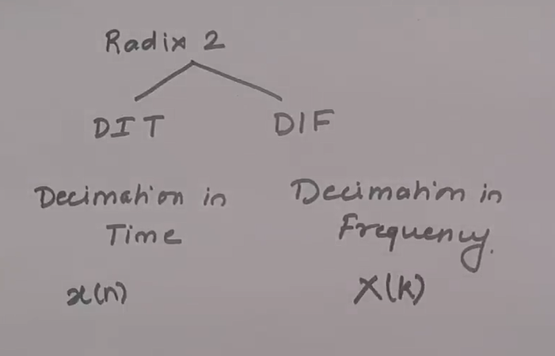

Slide 5
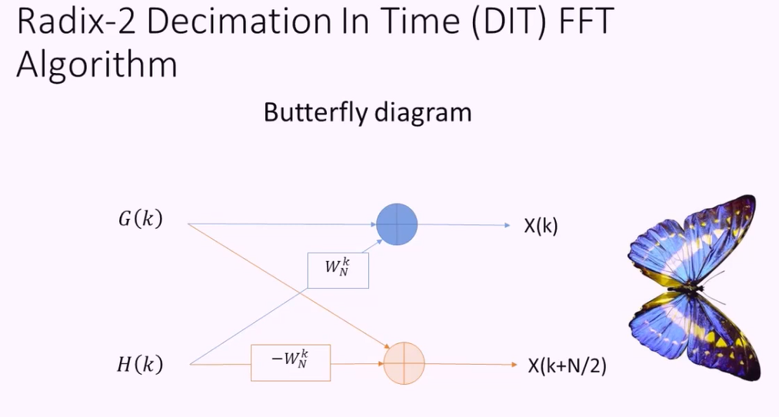

Slide 6
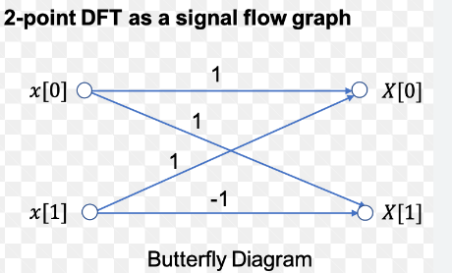

Slide 7
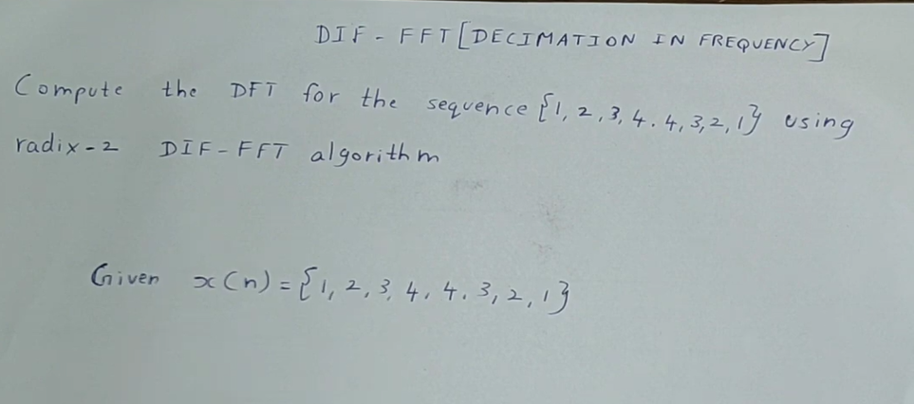

Slide 8
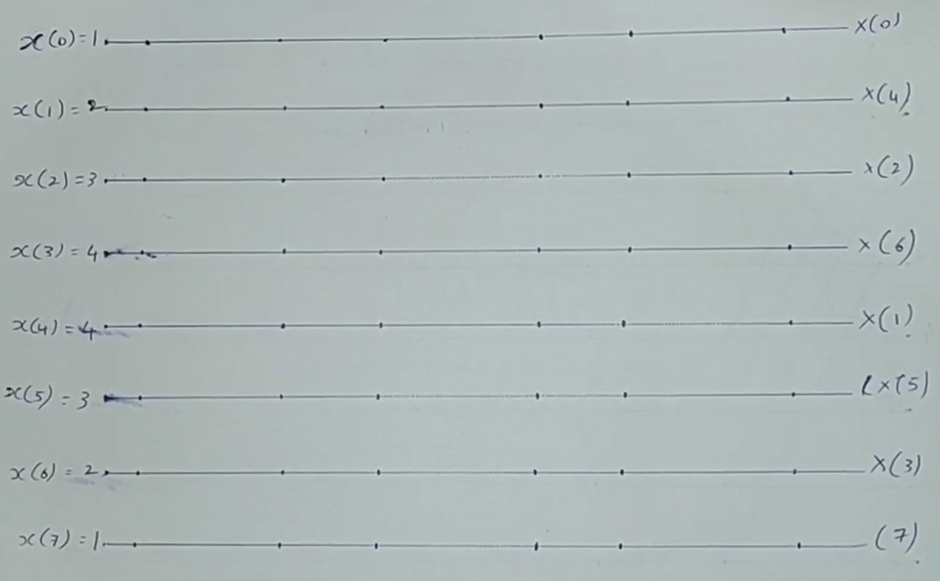
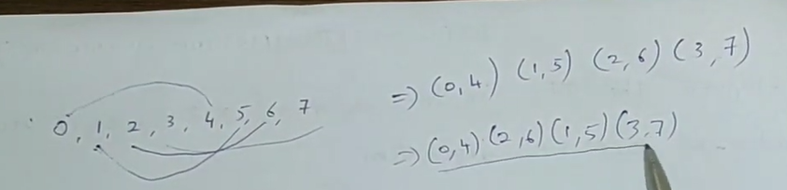
Input is in Normal order 0, 1, ,2,3,4,5,6,7
Bit reverse order
First even bit than odd bit

Slide 9
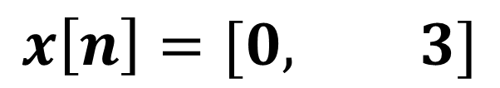
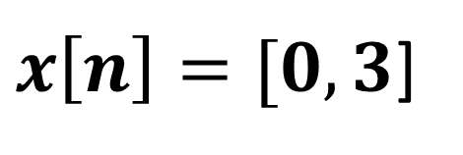
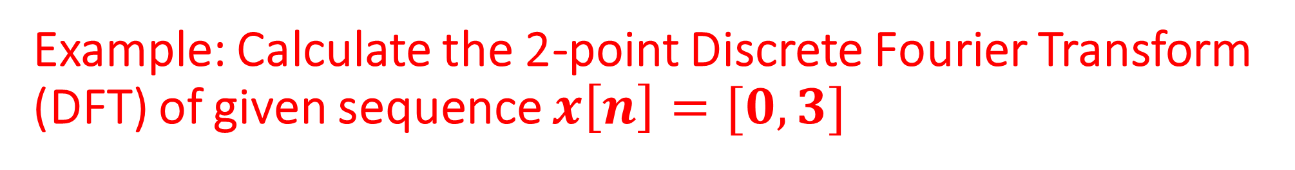
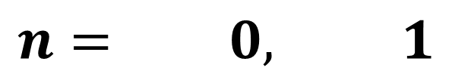
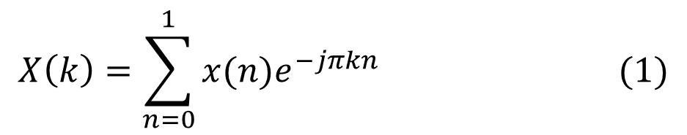
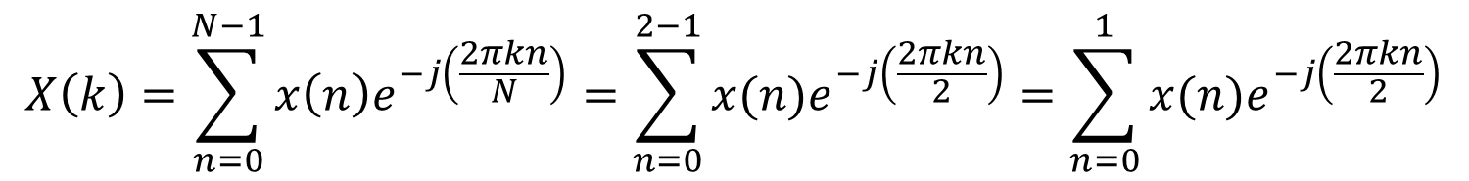
Example: Calculate the 2-point Discrete Fourier Transform (DFT) of given sequence $x\left[n\right]=[0,3]$
$x\left[n\right]=[0,3$]
SOLUTION
$$x\left[n\right]=[0, 3]$$
x(0) = 0
x(1) = 3
$$n= 0, 1$$
STEP:-1: Check Length of Sequence is = N = 2, then value of k is also two, k = 0, 1
$$X\left(k\right)=\sum_{n=0}^{N−1}{x\left(n\right)e^{−j\left(\frac{2πkn}{N}\right)}=\sum_{n=0}^{2−1}{x(n)e^{−j\left(\frac{2πkn}{2}\right)}}=\sum_{n=0}^{1}{x(n)e^{−j\left(\frac{2πkn}{2}\right)}}}$$
$$X\left(k\right)=\sum_{n=0}^{1}{x(n)e^{−jπkn}} (1)$$

Slide 10

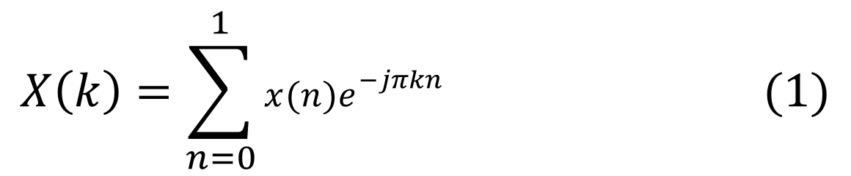
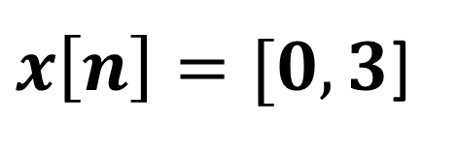
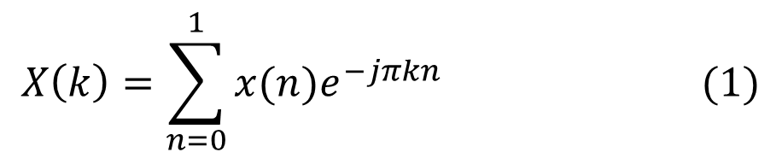
$x\left[n\right]=[0,3$]
STEP:-2: Put k = 0 in equation (1)
$$X\left(k\right)=\sum_{n=0}^{1}{x(n)e^{−jπkn}} (1)$$
x(0) = 0
x(1) = 3
$$X\left(0\right)=\sum_{n=0}^{1}{x(n)e^{−jπkn}}=\sum_{n=0}^{1}{x(n)e^{0}}=\sum_{n=0}^{1}{x\left(n\right)∗1=\sum_{n=0}^{1}{x\left(n\right)=x\left(0\right)+x\left(1\right)=0 +3=3}}$$
STEP:-2: Put k = 1 in equation (1)
$$X\left(k\right)=\sum_{n=0}^{1}{x(n)e^{−jπkn}} (1)$$
$$X\left(1\right)=\sum_{n=0}^{1}{x(n)e^{−jπkn}}=\sum_{n=0}^{1}{x(n)e^{−jπ∗1∗n}}=\sum_{n=0}^{1}{x(n)e^{−jπn}}$$
$$X\left(1\right)=x\left(0\right)e^{0}+x\left(1\right)e^{−jπ∗1}= x\left(0\right)∗1+x\left(1\right)e^{−jπ}$$

Slide 11
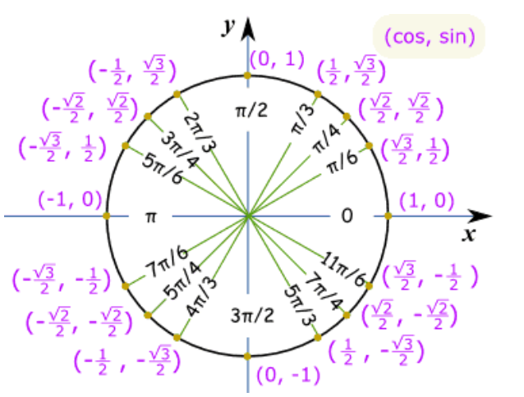
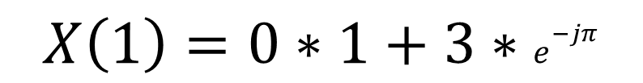
$x\left[n\right]=[0,3$]
$$X\left(1\right)=x\left(0\right)e^{0}+x\left(1\right)e^{−jπ∗1}= x\left(0\right)∗1+x\left(1\right)e^{−jπ}$$
x(0) = 0
x(1) = 3
$$X\left(1\right)=0∗1+3∗e^{−jπ}$$
$$X\left(1\right)=3∗e^{−jπ}=3∗e^{−j\left(π\right)}=3\left(−1+j0\right)=−3$$
$$X\left[k\right]=\left[X\left(0\right), X\left(1\right)\right]=\left[3,−3\right] Answer$$

Slide 12
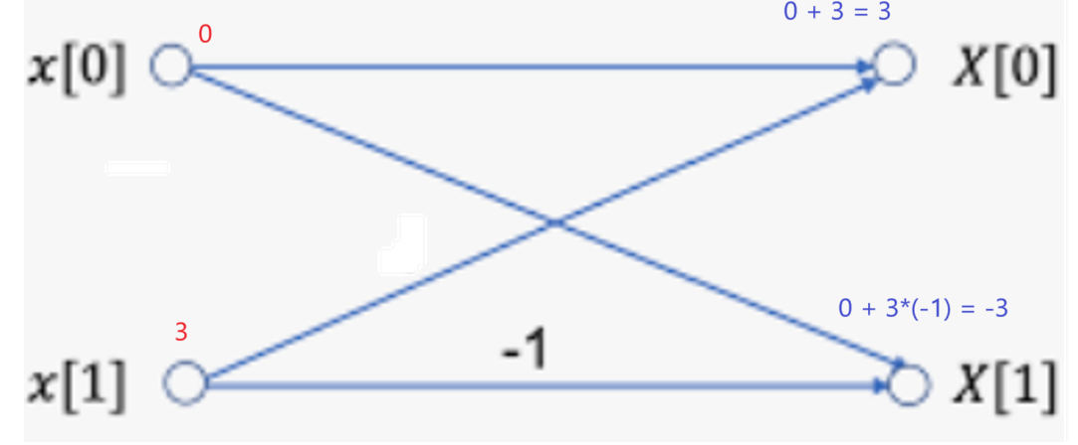


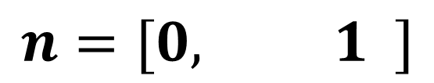
Example: Apply FFT Algorithm to Calculate 2 point DFT of given sequence $x\left[n\right]=[0, 3]$
SOLUTION
$$x\left[n\right]=[0, 3]$$
$$n=[0, 1 ]$$
$$X\left[k\right]=\left[X\left(0\right), X\left(1\right)\right]=\left[3, −3\right] Answer$$

Slide 13
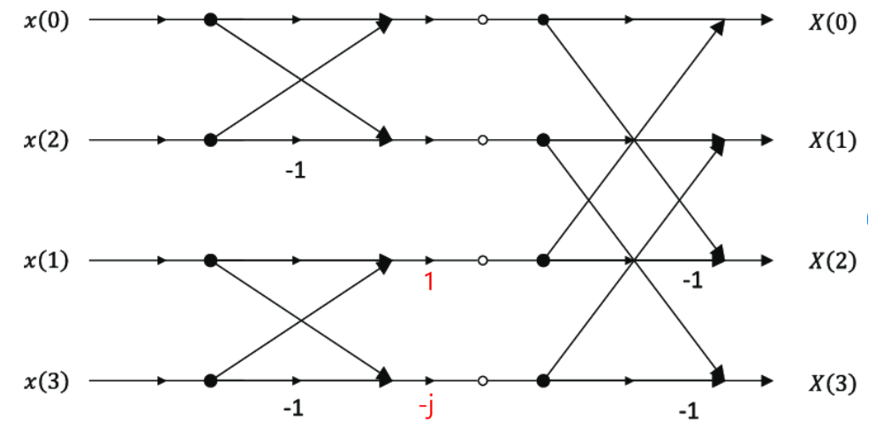
4-POINT DFT BUTTERFLY GRAPH

Slide 14
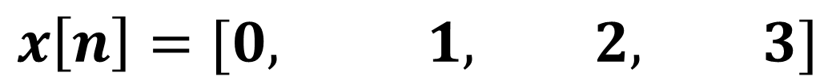

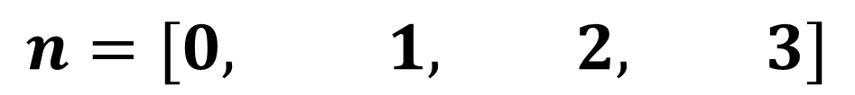
Example: Apply FFT Algorithm to Calculate 4 point DFT of given sequence $x\left[n\right]=[0, 1,2,3]$
SOLUTION
$$x\left[n\right]=[0, 1, 2, 3]$$
$$n=[0, 1, 2, 3]$$

Slide 15
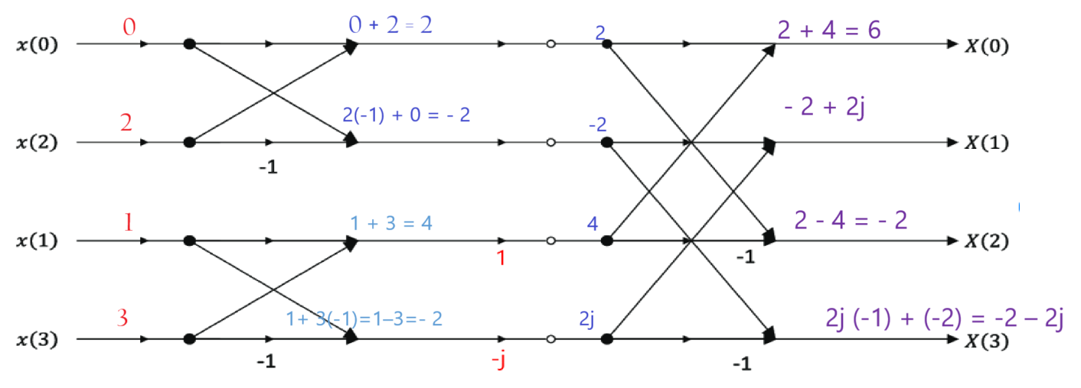
$$X\left[k\right]=\left[X\left(0\right), X\left(1\right), X\left(2\right), X(3)\right]=\left[6, −2+2j, −2, −2−2j\right] Answer$$

Slide 16
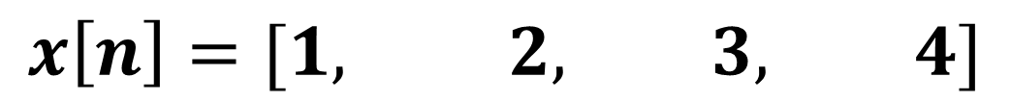
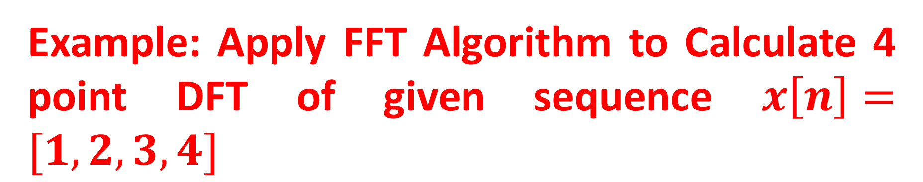
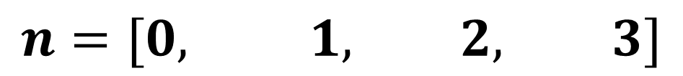
Example: Apply FFT Algorithm to Calculate 4 point DFT of given sequence $x\left[n\right]=[1,2,3,4]$
SOLUTION
$$x\left[n\right]=[1, 2, 3, 4]$$
$$n=[0, 1, 2, 3]$$

Slide 17
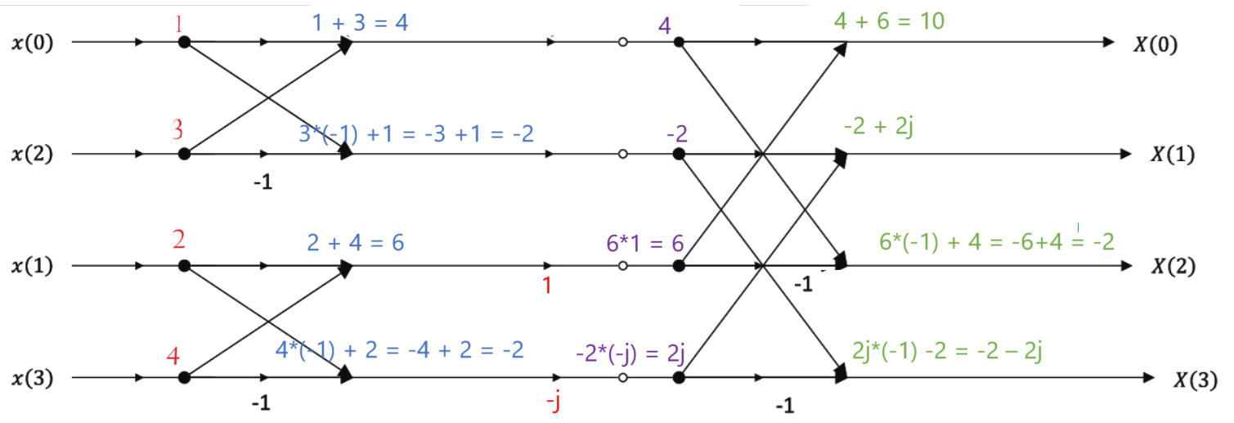
$$X\left[k\right]=\left[X\left(0\right), X\left(1\right), X\left(2\right), X(3)\right]=\left[10, −2+2j, −2, −2−2j\right] Answer$$

Slide 18
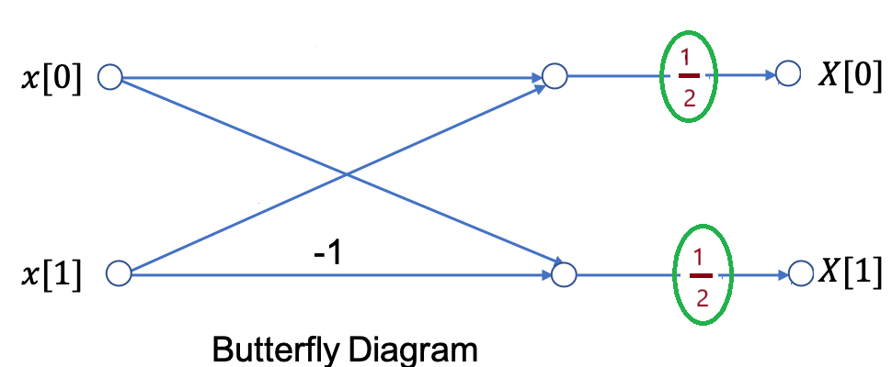
2-POINT IVERSE FAST FOURIER (IFFT) TRANSFORM BUTTERFLY DIAGRAM

Slide 19
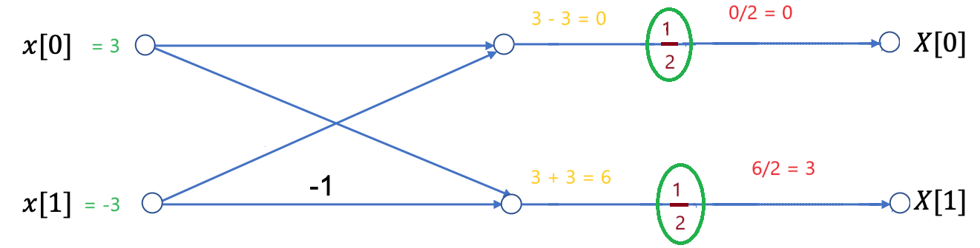

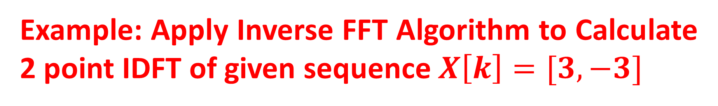
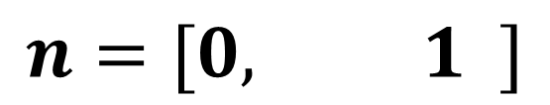
Example: Apply Inverse FFT Algorithm to Calculate 2 point IDFT of given sequence $X\left[k\right]=[3, −3]$
SOLUTION
$$x\left[n\right]=[3, −3]$$
$$n=[0, 1 ]$$
$$x\left[n\right]=\left[x\left(0\right), x\left(1\right)\right]=\left[0, 3\right] Answer$$

Slide 20
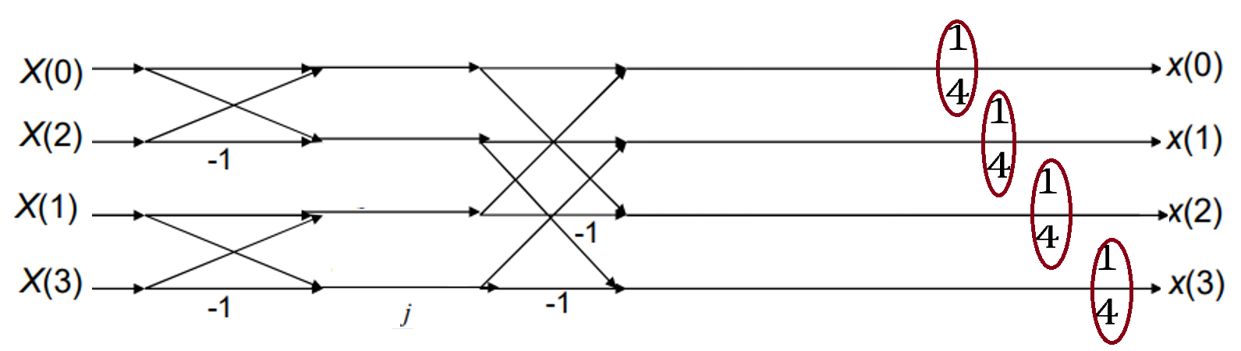
4POINT DFT AND 4POINT IDFT BUTTERFLY GRAPH
DFT
IDFT

Slide 21
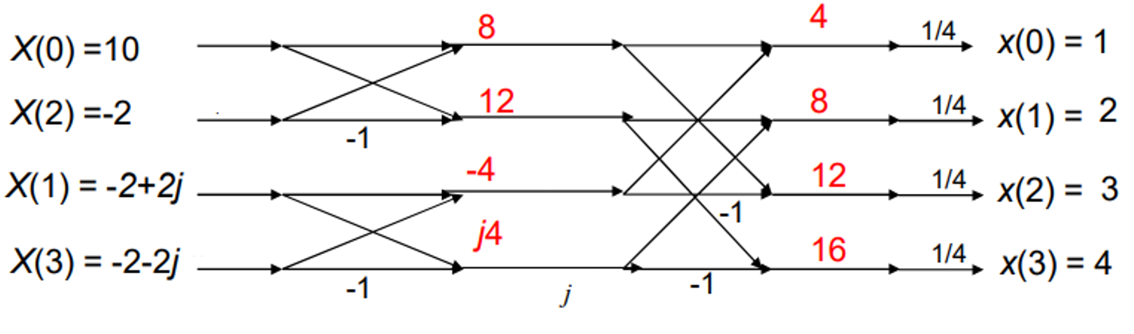
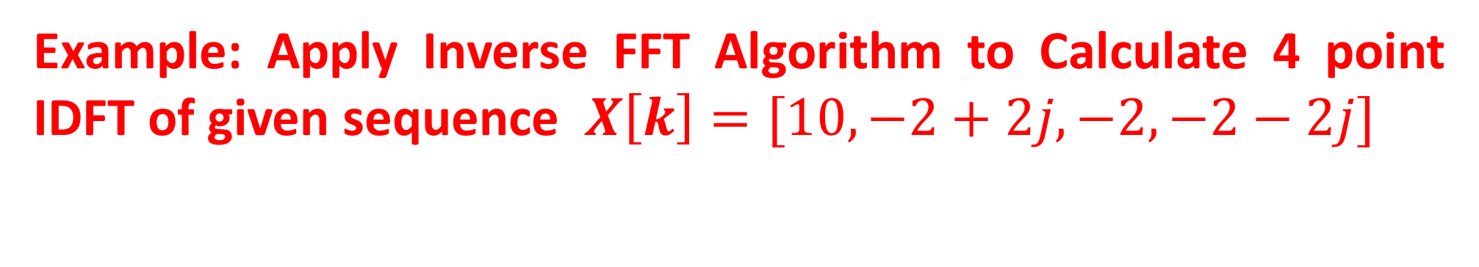
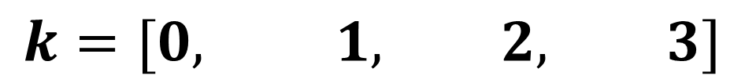
Example: Apply Inverse FFT Algorithm to Calculate 4 point IDFT of given sequence $X\left[k\right]=[10, −2+2j, −2, −2−2j]$
SOLUTION
$$X\left[k\right]=[10, −2+2j, −2, −2−2j]$$
$$k=[0, 1, 2, 3]$$
$$x(n) =\left[x\left(0\right), x\left(1\right), x\left(2\right), x(3)\right]=\left[1,2,3,4\right] Answer$$

Slide 22
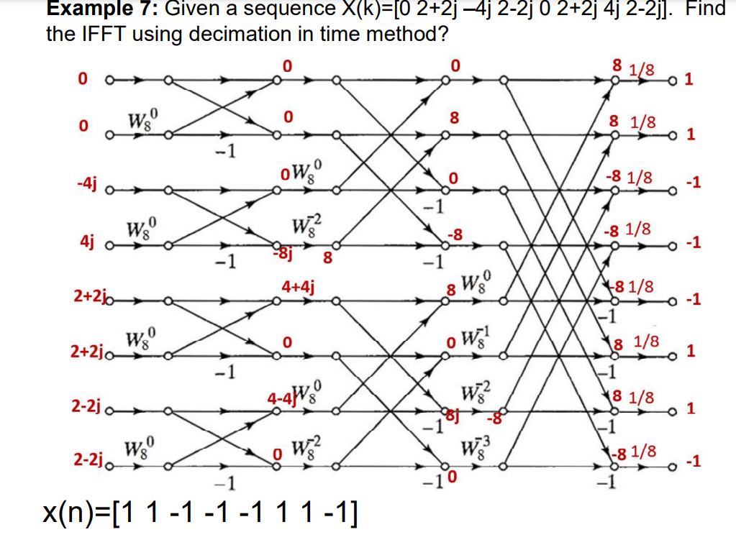

Slide 23
Q: Can we apply FFT on odd (3,5,7,9) point DFT?
Ans: No, Because it can not create pairs

